Slide 1

Course in Surgery, IX semester 2025/26
University of Belgrade, Faculty of medicine
Chair for Surgery and Anesthesiology

Slide 2
General information
Course in surgery has several sub-courses
  Anesthesiology (including simulations)
  General & Digestive surgery
  Thoracic surgery
  Cardiac and Vascular surgery
  Plastic surgery
  Orthopedic surgery, neurosurgery, plastic, endocrine,
  urology, pediatric,
  surgical oncology...
IX
semester
X
semester

Slide 3
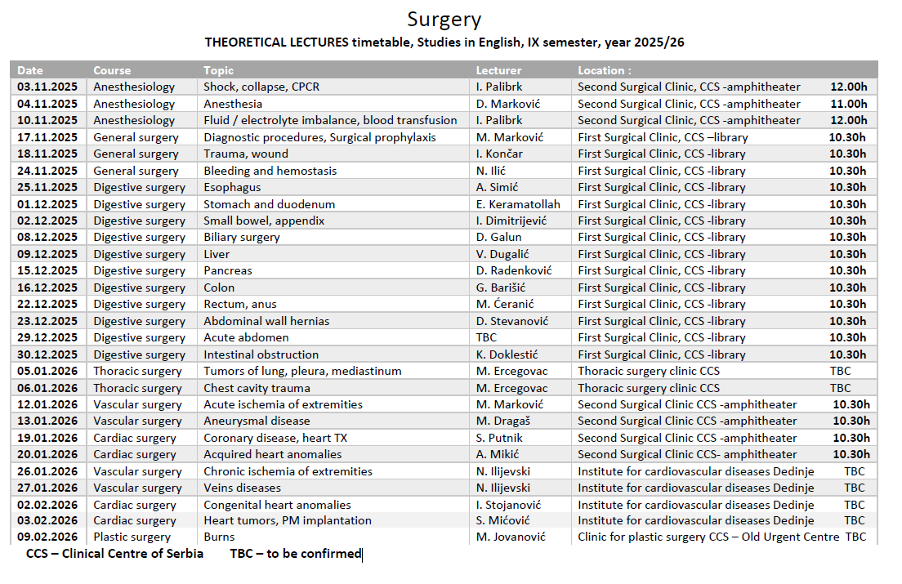

Slide 4
Instructions
Lectures (theoretical and practicals) will be held in live format
Practicals will be held in 14 Teaching bases, clinics and hospitals
Please note that first and second week have different timetable than the rest of the course (read further!)
There will be 6 groups for practicals, each containing about 6-7 students except for the CPCR course in the Sim Centre (two groups, group 1 first week, group 2 second week)
Theoretical lectures and practicals in Surgery are scheduled on Mondays and Tuesdays as noted in the timetable, except for the practicals in Simulation center (first and second week, November 03-14th )

Slide 5
First and second week (November 03-14th)
Subcourse: Anesthesiology / reanimatology
Practicals location: CPCR Simulation centre (see the map later)
Theoretical lectures will be on Mondays and Tuesdays (November 3,4, and 10th) at the amphitheatre of the Second Surgical Clinic (whole group!)
Simulation Practicals are every day (Monday from 8-11.30, Tuesday, Wednesday from 8-10.30h); Thursday from 14-17.30h and Friday from 12.30-16h.
For Practicals, students are diveded into two subgroups (see next page!)
First group attends Sim practicals every day during the first week (November 3-7th), the second group has no practicals during this week
Second group attends Sim practicals every day during the second week (November 10-14th), the first group has no practicals during this week (note that 11th is a public holiday, no lectures & practicals that day)
This relatively complex schedule was created in order to avoid overlap with other courses

Slide 6
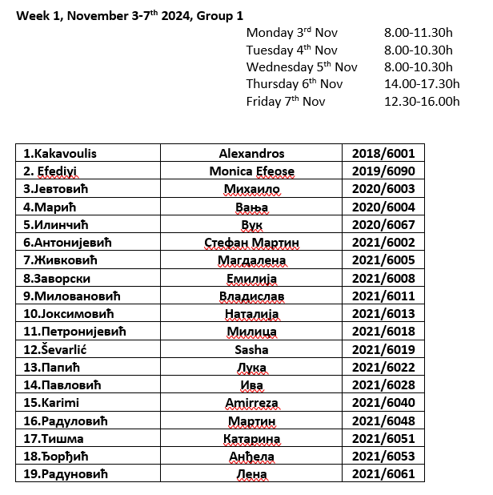
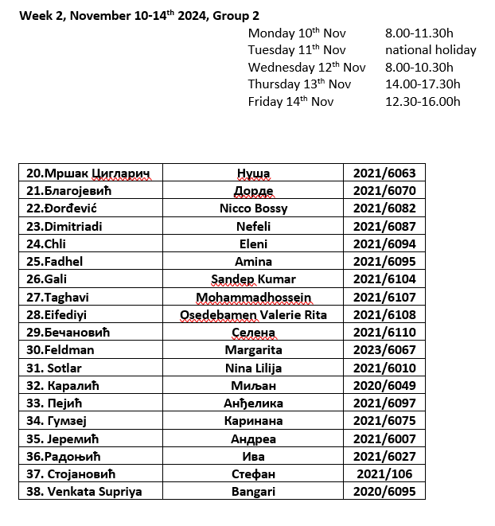
Groups for first two weeks practicals (Sim Centre)

Slide 7
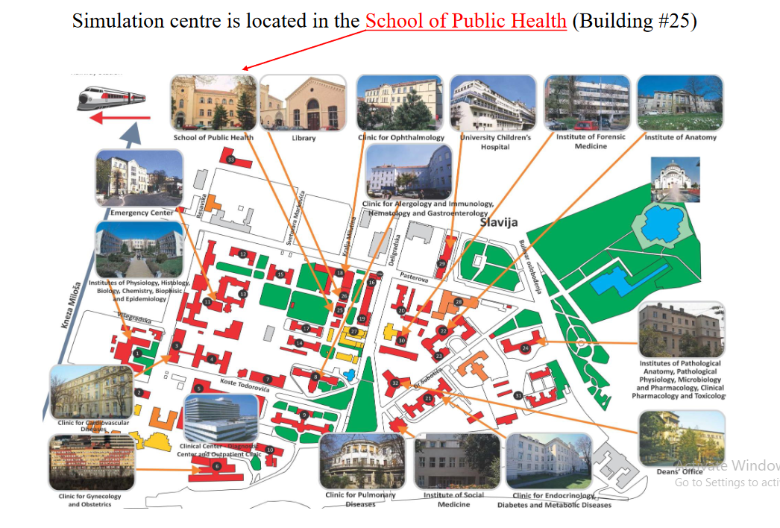

Slide 8
November 17th – December 30th
Subcourses: General and Digestive surgery
Theoretical lectures will be held at the Library of the First Surgical Clinic, from 10.30h
Practicals location: First surgical Clinic, and New Urgent Centre (new building), of the Clinical Centre of Serbia (CCS)
Meeting point for 17th Nov: Posterior entrance of the First surgical Clinic, in the basement
Practicals start at 8.15h (meeting point at 08.00h, groups timetable will be posted later)

Slide 9
January 5th – the end of the semester
Subcourses: Thoracic surgery, Cardiovascular surgery, Plastic surgery
Theoretical lectures and Practicals locations:
  Clinic for Thoracic Surgery, New building of the Clinical Centre of Serbia (CCS)
  Clinics for Vascular and Cardiac surgery, Second Surgical Clinic -Clinical Centre of Serbia (CCS)
  Institute for Cardiovascular Diseases Dedinje
  Clinic for Plastic and reconstructive surgery, Old Urgent Centre – Clinical Centre of Serbia
Meeting points and practicals timetables will be posted later

Slide 10
Other informations
For practicals, students must have the white coat above clothes and should have stethoscopes
The attendance of theoretical lectures and practicals will be graded from 0-10 points (pre-final test activities), thus making 10% of total possible points of final mark - see „Grading policy“:
http://studiesinenglish.med.bg.ac.rs/courses/fifth-year/surgery/
Students that missed more than 1/3 of practicals (for any reason) cannot get semestral signature (see the Rulebook for the studies in English, paragraph 35-6).

Slide 11
Contact:
Course director:
Miroslav Marković, MD, PhD
General and Vascular Surgeon, full Professor of Surgery
Second Surgical Clinic, Clinical Centre of Serbia
drmiroslav@gmail.com
Whatsapp / Viber : +381637135746

